Slide 1
End-to end Tracing, tracing Kubernetes
Aditya Chechani
Joshua Manning
Reet Chowdhary
Runzhou Han
2/8/2018
Taiga: https://tree.taiga.io/project/msdisme-2018-bucs528-template-7/
GitHub: https://github.com/BU-NU-CLOUD-SP18/Cross-Layer-Tracing-in-Kubernetes
Notes:
‹#›

Slide 2
Vision & Goals
*
End-to-end tracing for app behavior on Kubernetes
Identify issues
Add in trace points to “data plane” features
Ingress - An API object that manages external access to the services in a cluster, typically HTTP.
Services - An abstraction which defines a logical set of Pods and a policy by which to access them - sometimes called a micro-service.
‹#›

Slide 3
User story
*
Bottlenecks
Facing these problems…
End-to-end tracing
Debug
Kubernetes users,
Including companies and individuals
Latency
Analyze
Performance
‹#›

Slide 4
Scope & Features
*
Instrument the services section of Kubernetes with trace points
Focus on data-plane portion
‹#›

Slide 5
Concepts
*
Containers provide an isolated environment with a unique namespace
App may run with its environment
Apps can only use the resources defined in this namespace
Application
Web server
Container
‹#›

Slide 6
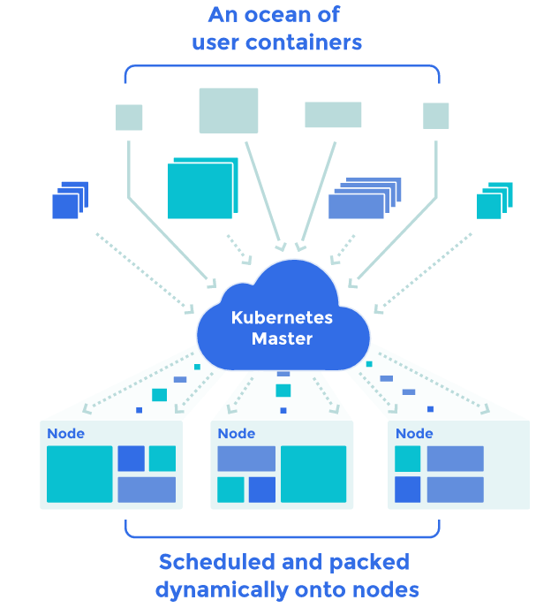
Concepts
*
Kubernetes: a container deployment orchestrator,
Where tracing will be implemented.
Kubernetes platform automates deploying, scaling, and managing containers
‹#›
Image from here

Slide 7
Concepts
*
Tracing: Tracing events labeled by a unique ID of a request to know apps’ behavior.
Tracing ID is a local variable
Propagation of request IDs tied to a specific request
API
API
API
API
”Thread” of Tracing ID
Request
Node1
Node2
‹#›

Slide 8
Concepts
*
Jaeger: a distributed tracing used for monitoring microservices-based distributed systems.
HotRod: a sample application that has had tracing implemented by Jaeger.
OSProfiler: Another tracing implementation that may be used.
‹#›

Slide 9
Trello
Acceptance Criteria
Implement end-to-end tracing for n number of requests to a distributed system containing at least n number of machines in parallel through the Kubernetes data-plane.

Slide 10
Release Planning
Short Term Goals:
Get Kubernetes on our machines
Create and run applications in containers
Implement HotRod using Jaeger
Tutorials on Kubernetes & tracing
‹#›

Slide 11
THANK YOU
*
‹#›

